Slide 1
Year 4 Multiplication Tables Check (MTC)
June 2026

Slide 2
Important information about multiplication tables check (MTC):
The MTC determines if Year 4 children can fluently recall their multiplication tables.
They are designed to help schools identify which children require more support to learn their times tables.
There is no ‘pass’ rate or threshold which means that, unlike the Phonics Screening Check, children will not be expected to re-sit the check.

Slide 3
When the check will take place:
There will be a 2 week window from Monday 1st June to Friday 12th June 2026 for schools to administer the check. Monday 1st June is a TD day – we will try to administer the test during the first week.
There is no set day to administer the check and children are not expected to take the check at the same time.
All eligible Year 4 children in England will be required to take the check.
There is a ‘Try it out’ area, provided by the DfE, which will take place in school.
We are also taking part in the Officially Unofficial MTC on TT Rockstars.

Slide 4
How the check is carried out:
The check will be fully digital.
Answers will be entered using a keyboard, by pressing digits using a mouse or using an on-screen number pad.
Usually, the check will take less than 5 minutes for each child.
The children will have 6 seconds from the time the question appears to input their answer. (6 seconds per answer means that children must be able to read, recall and enter their response within that time. Whatever is written in the answer box at the end of 6 seconds will be counted as the answer.)
There will be a total of 25 questions with a 3 second pause in-between questions.
There will be 3 practice questions before the check begins.

Slide 5
Specific arrangements for the check:
Some children will be eligible for specific arrangements:
Colour contrast;
Font size adjustment;
‘Next’ button (alternative to 3-second pause);
Removing on-screen number pad;
An adult to input answers;
Audio version;
Audible time alert.

Slide 6
The check questions:
Each child will be randomly assigned a set of questions
There will only be multiplication questions in the check, not division facts.
The 6, 7, 8, 9 and 12 times tables are more likely to be asked, as these are the hardest for most children to learn. It’s a good idea to focus on these tricky times tables with your child at home.
Children will not see their individual results when they complete the check.

Slide 7
How best to prepare your child for the check:
Remind them that the check should last no more than 5 minutes.
If you want to go over timestables, make them fun.
If you have any concerns, talk to your child’s teacher.
If your child has any concerns, encourage them to talk to a trusted adult (for example, yourself, their teacher).
If you’re looking to support your child further with maths at home, there are lots of good websites with free resources.

Slide 8
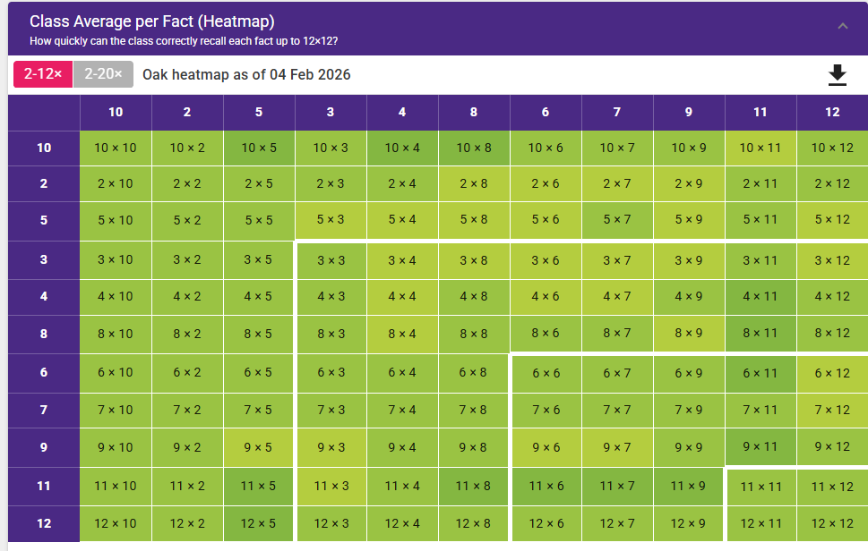
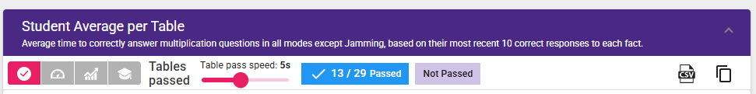
Oak heat map as of 4th February

Slide 9
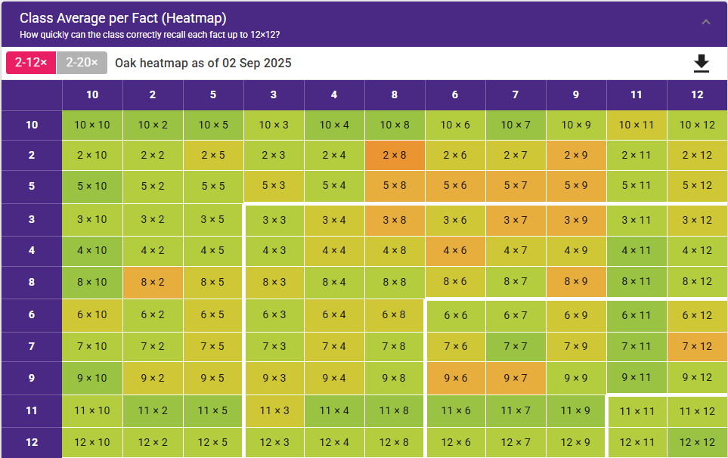
September - Oak

Slide 11
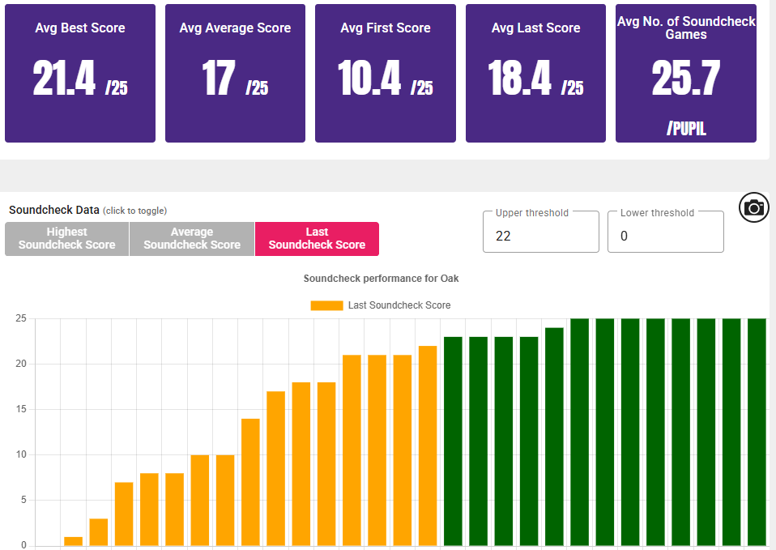
Oak average scores as of 4th February

Slide 12
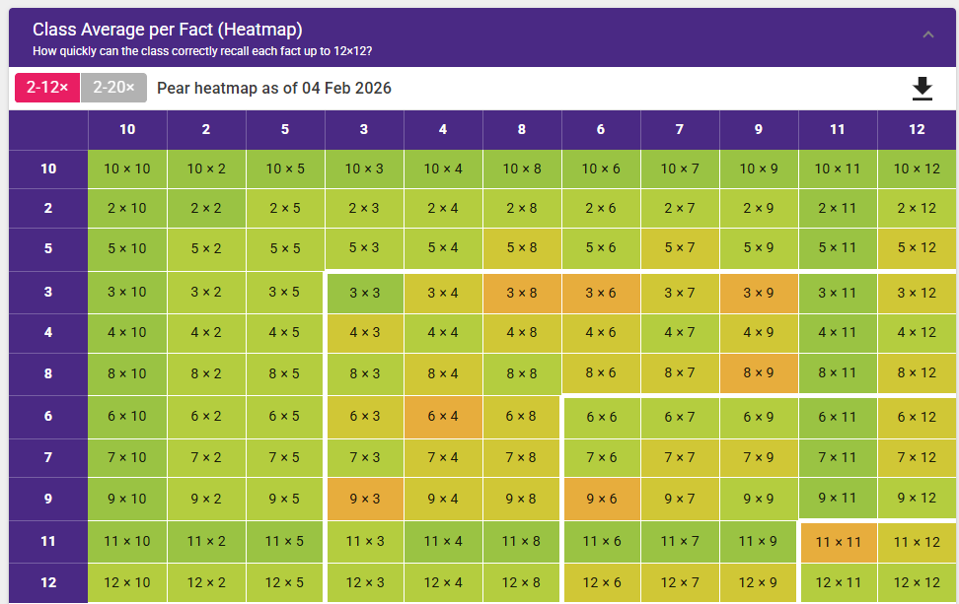
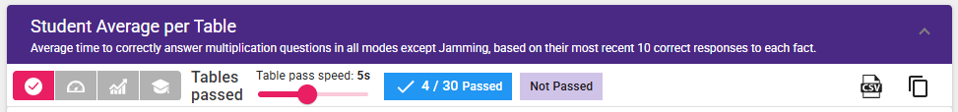
Pear heat map as of 4th February

Slide 13
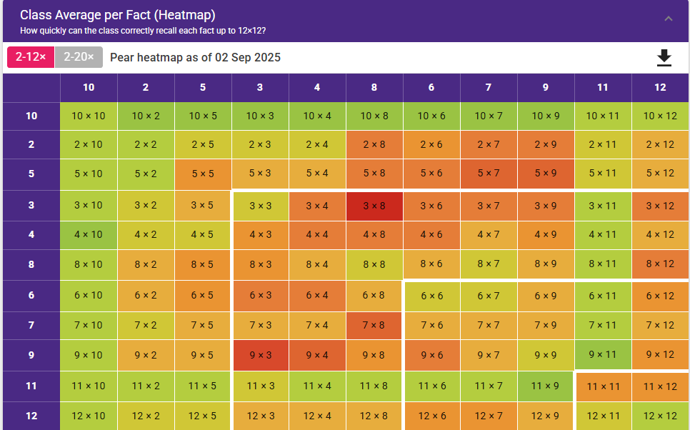
September - Pear

Slide 15
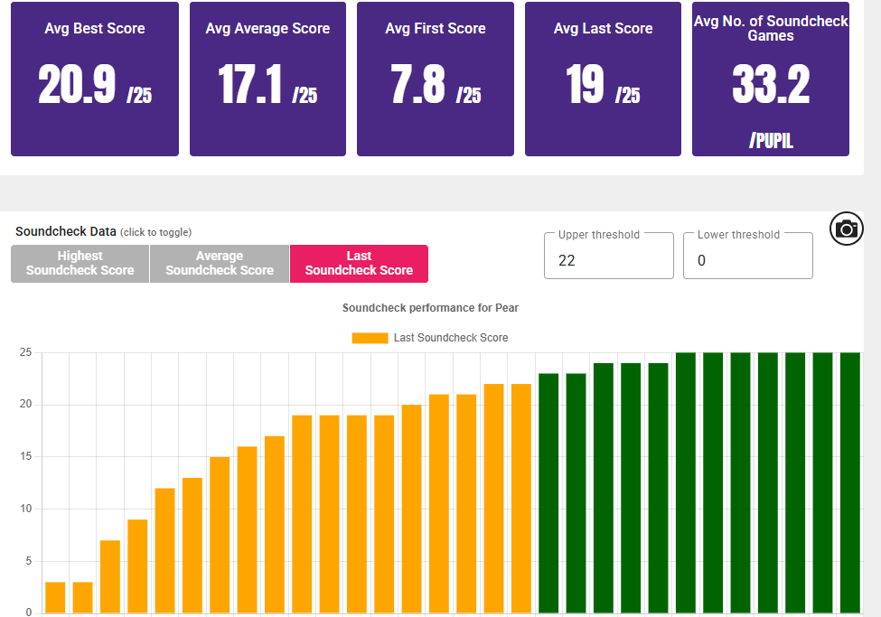
Pear average scores as of 4th February

Slide 16
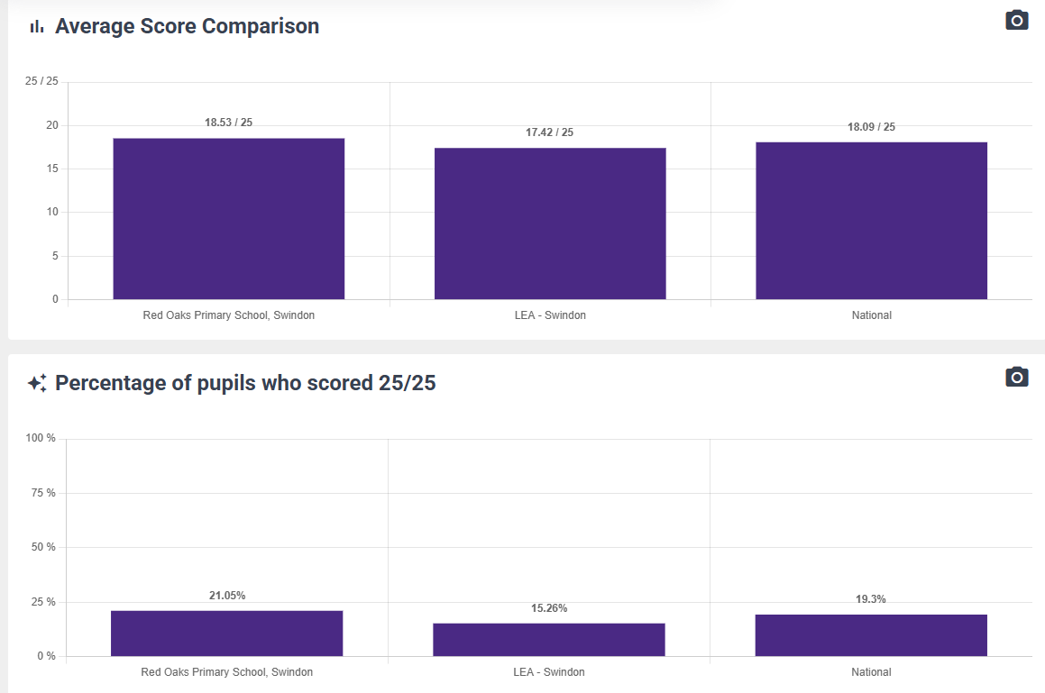
Where is Red Oaks tracking

Slide 17
How the MTC is reported
They add all the scores and divide by the amount of children taking part in the school.
2024 results:
National average: 20.66%
Red Oaks average: 21.43%
% of children scoring 25/25:
National average: 35.2%
Red Oaks average: 46.7%
2025 results:
National average: 21%
Red Oaks average: 23.86%
% of children scoring 25/25:
National average: 37%
Red Oaks average: 70%
So far this year …
Average of 18.7%
With 12 children regularly scoring 25/25 – 20%

Slide 18
Games to try:
Climb the stairs counting in multiples
Play time tables games verbally
Listen and sing along to times tables songs
Take it in turns to say times tables in funny voices
Play maths games online:
Hit the Button- https://www.topmarks.co.uk/maths-games/hit-the-button
Snappy Maths http://www.snappymaths.com/multiplication/multiplication.htm
Time table games: https://www.timestables.co.uk/games/
Maths frame: https://mathsframe.co.uk/en/resources/resource/477/Multiplication-Tables-Check
TT Rockstars: https://ttrockstars.com/

Slide 19
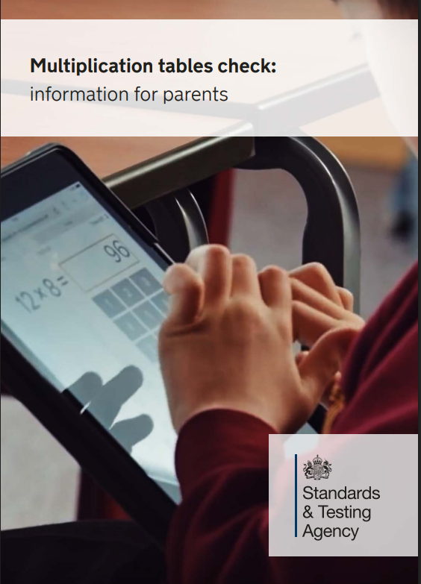
We really thank you for your support and wish our Y4 pupils all the best for the upcoming MTC in June 2026.
Thank for taking the time to read this information.

