Slide 1

1.2 Part–part–whole – step 1:1

Slide 2
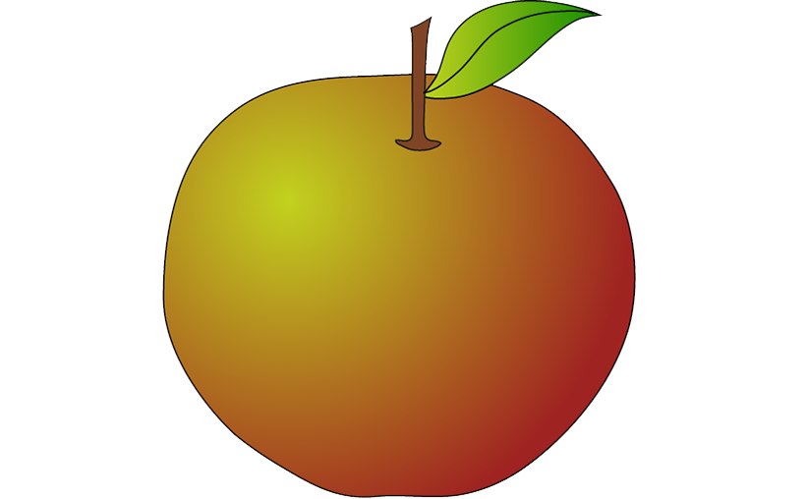
1.2 Part–part–whole – step 1:1

Slide 3
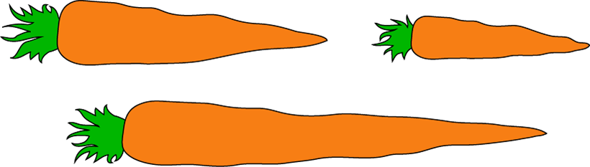
1.2 Part–part–whole – step 1:2

Slide 4


1.2 Part–part–whole – step 1:3

Slide 5
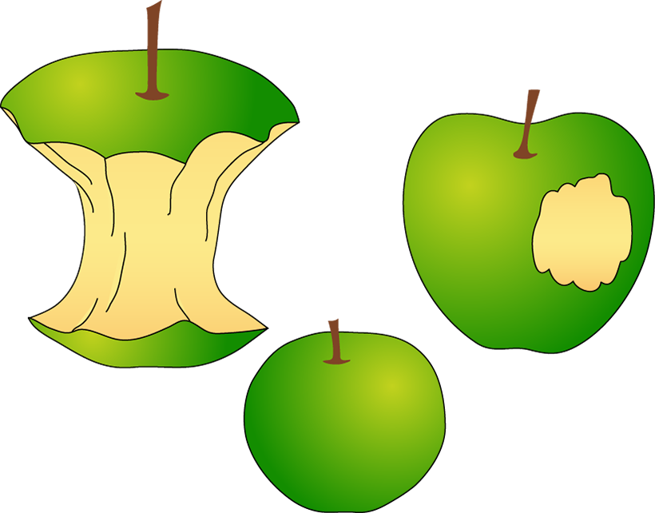
1.2 Part–part–whole – step 1:3

Slide 6
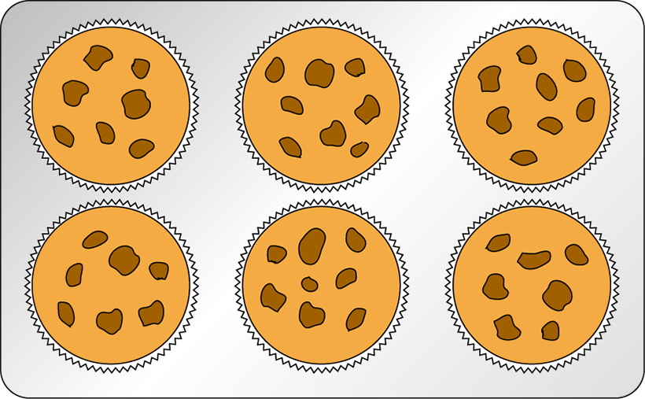
1.2 Part–part–whole – step 3:1

Slide 7
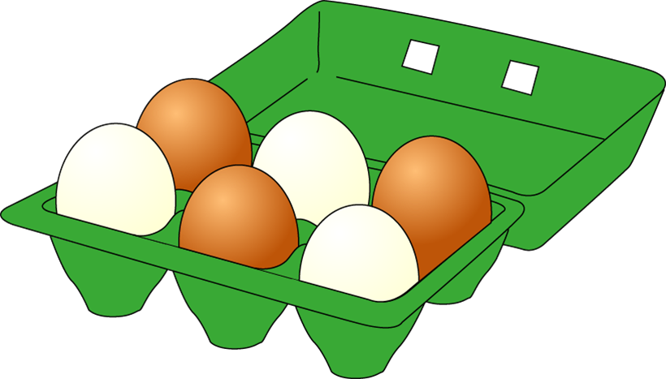
1.2 Part–part–whole – step 3:2

Slide 8
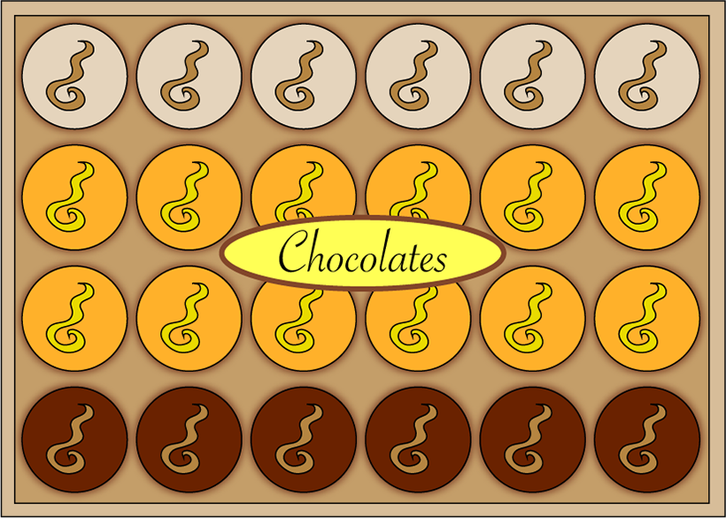
1.2 Part–part–whole – step 3:2

Slide 9
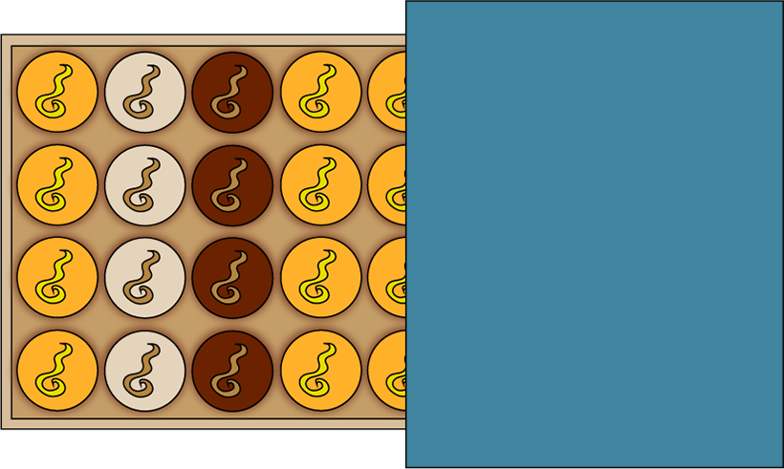
1.2 Part–part–whole – step 3:2

Slide 10

1.2 Part–part–whole – step 3:4

Slide 11

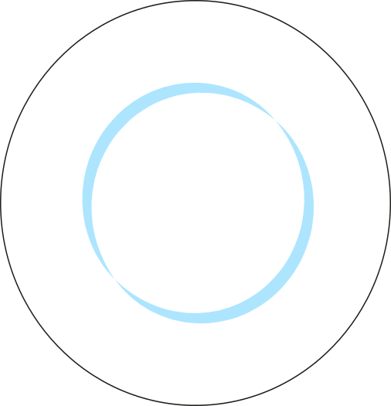
1.2 Part–part–whole – step 3:5

Slide 12
1.2 Part–part–whole – step 3:5

Slide 13
1.2 Part–part–whole – step 3:5

Slide 14
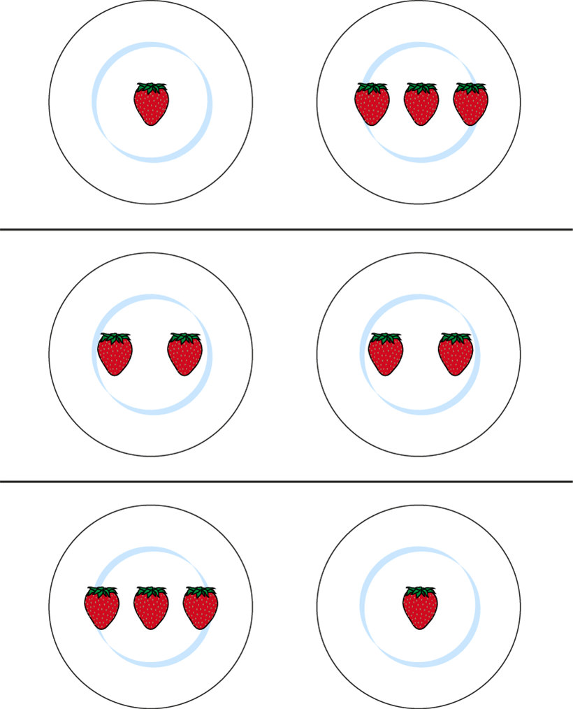
1.2 Part–part–whole – step 3:5

Slide 15


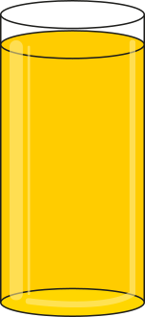
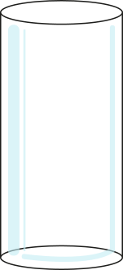
1.2 Part–part–whole – step 4:1

Slide 16
1.2 Part–part–whole – step 4:1

Slide 17
1.2 Part–part–whole – step 4:1
5

Slide 18
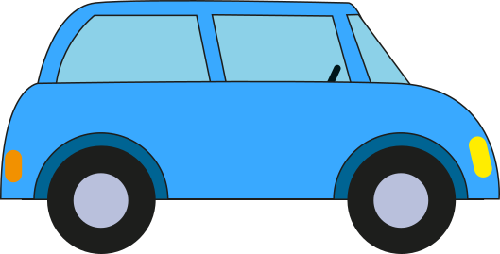



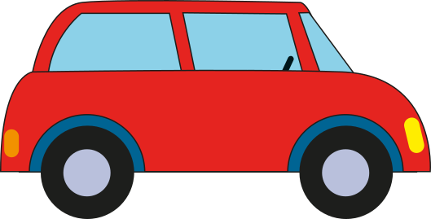
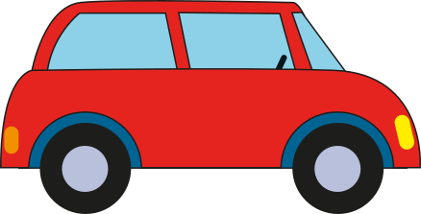
1.2 Part–part–whole – step 4:2

Slide 19
1.2 Part–part–whole – step 4:2

Slide 20
1.2 Part–part–whole – step 4:2

Slide 21




1.2 Part–part–whole – step 4:3
3

Slide 22
1.2 Part–part–whole – step 4:3
2
3
1

