Slide 1

Friday 23rd January 2026
Maths Parent workshop
Maths Lead: Mrs Tinson

Slide 2
Maths at Red Oaks
Teaching for mastery approach
White Rose maths
Mastering number/Number sense
TTRS/Numbots
Active maths/Orienteering
Cross trust competitions
Method videos on Dojo
Weekly homework in Y6
Multiplication check focus- Year 4

Slide 3

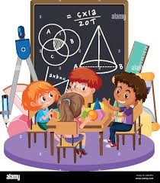
Teaching for mastery
Mathematics teaching for mastery assumes everyone can learn and enjoy mathematics.
At Red Oaks all children are known as Mathematicians
Mathematical learning behaviours are developed such that pupils focus and engage fully as learners who reason and seek to make connections.

Slide 4
How we teach Maths at Red Oaks
CPA approach- concrete, pictorial and abstract
White Rose maths scheme of learning
Focuses on representations, manipulatives to help and develop the children’s understanding about the structure of the maths- this is the mastery approach

Slide 5
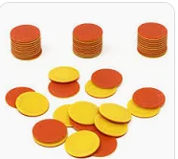
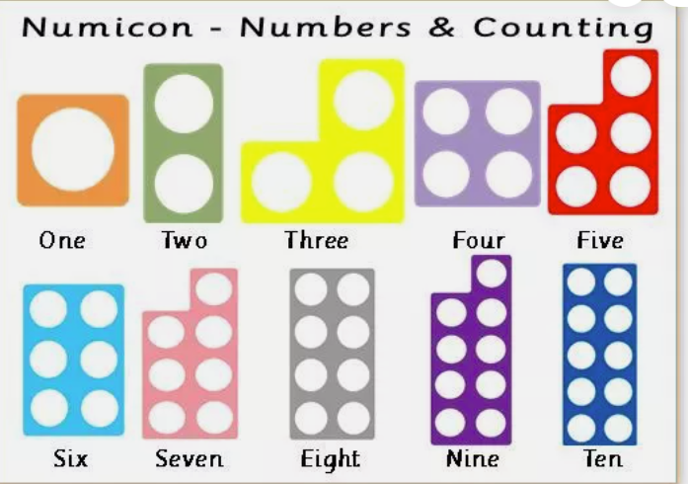
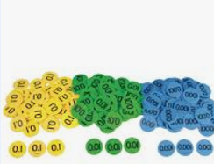
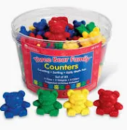
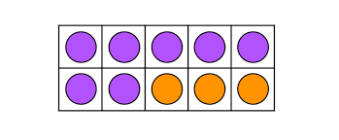
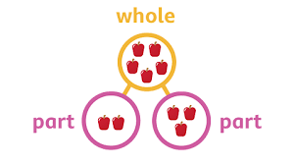
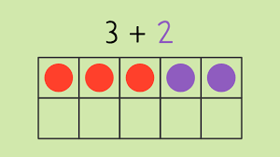
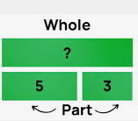
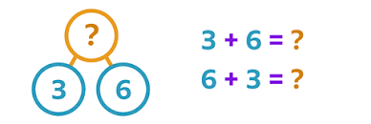
Using practical concrete resources to support their fluency and understanding

Slide 6
What does White Rose maths look like?
Blocks of learning
For each year group, the scheme of learning includes an overview of the maths that your child should be learning at any point in the year.
Each year is split into three terms (autumn, spring and summer), and each term comprises individual blocks of learning about a particular topic.

Slide 7
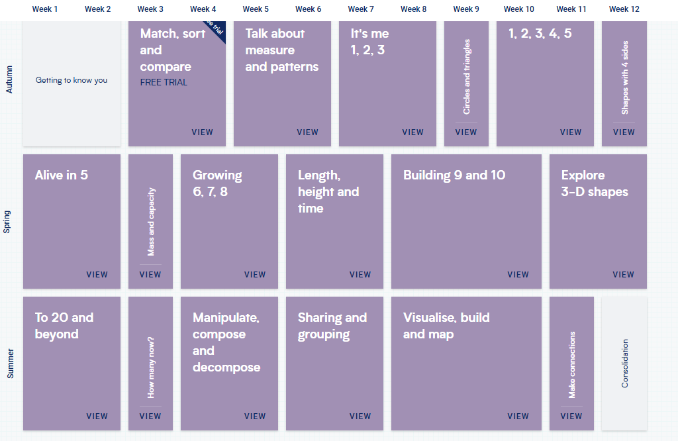
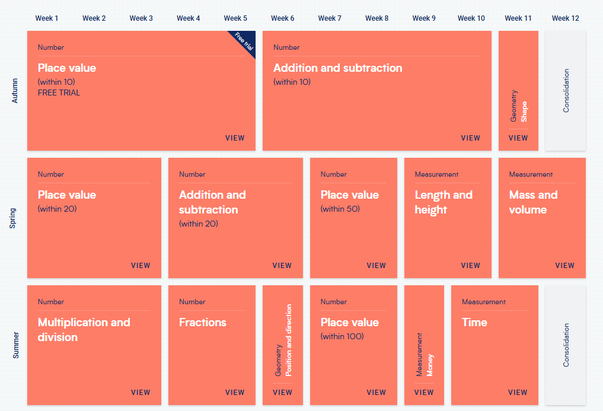
Reception
Year 1

Slide 8
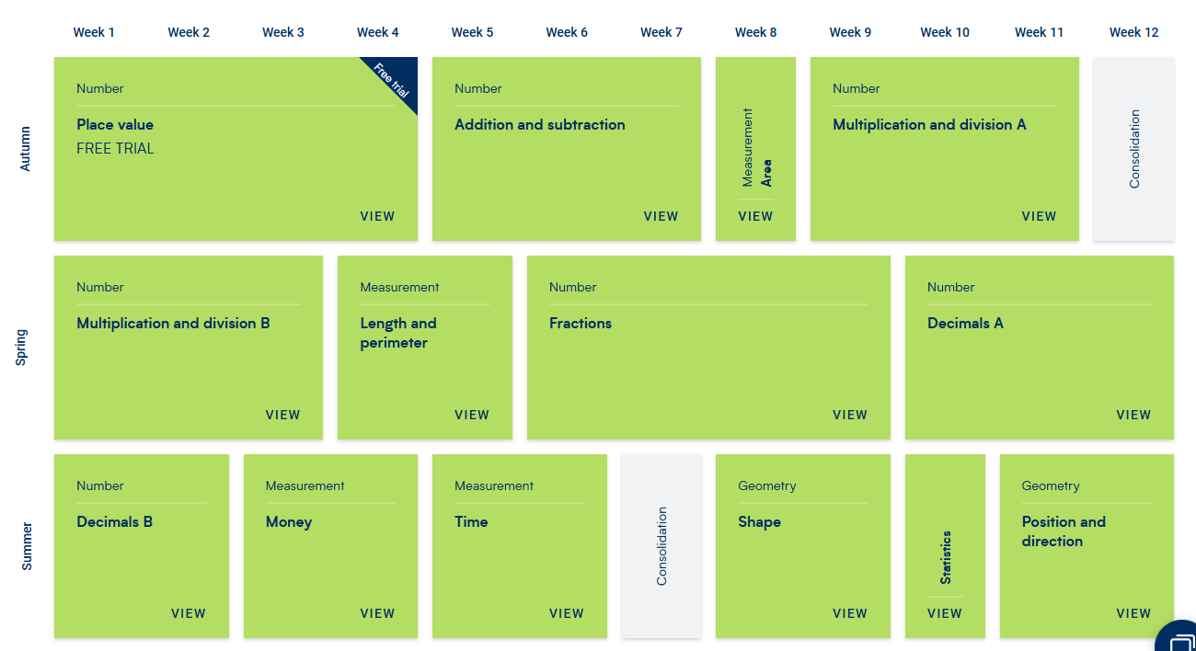
So the Year 4 overview looks like the picture, and Autumn Block 2, for example, focuses on addition and subtraction.

Slide 9
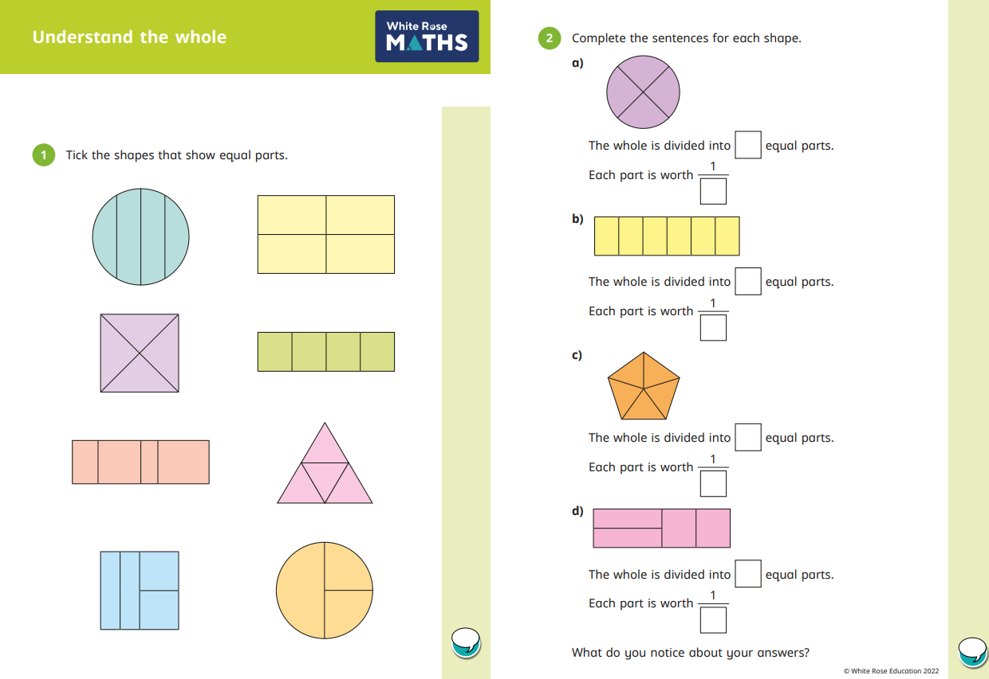
White Rose maths

Slide 10
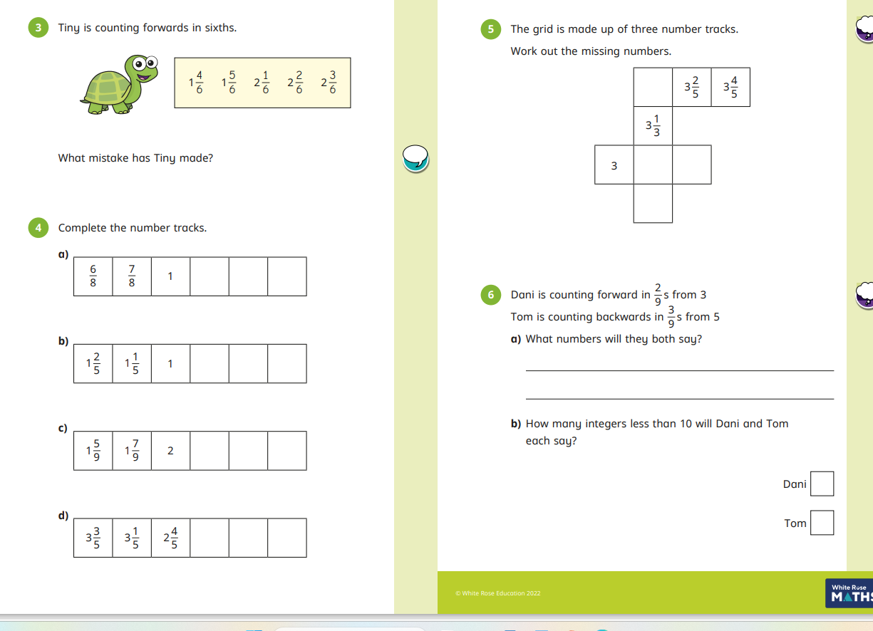
White Rose maths

Slide 11

Helping your child with maths (it’s more fun than you think!)
Many people think they “can’t do maths”, but with exciting new teaching approaches, we’re proving day by day that every child really can love and succeed in maths! What’s more, we want to make it as easy as possible for you to support your child’s learning, so here are some helpful tips from our fantastic team.

Slide 12


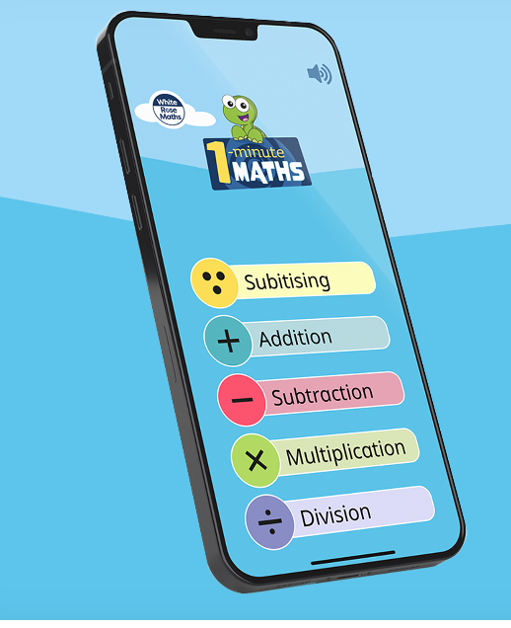

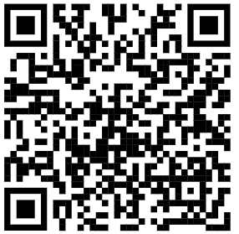
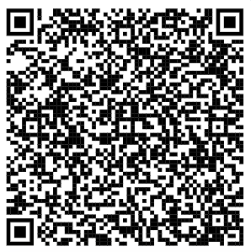

Support at home- how can you help?
Oxford Owl is a FREE website built to support you with your child's learning. You'll find age-specific reading and maths tips and activities, free eBooks, and lots of fun ideas to really bring your child's learning to life.
1 Minute maths app- FREE
https://home.oxfordowl.co.uk/maths/

Slide 13
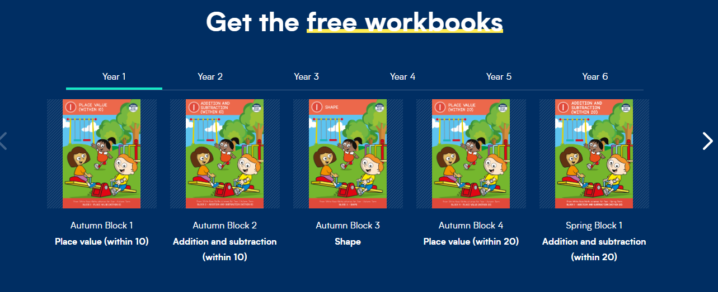

Slide 14
Fractions

Slide 15
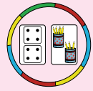
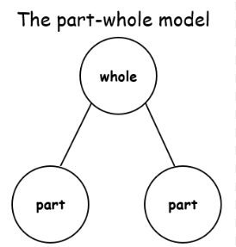
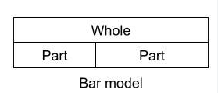
Fractions, Decimals and percentages
What is the whole?
What are the parts?

Slide 16
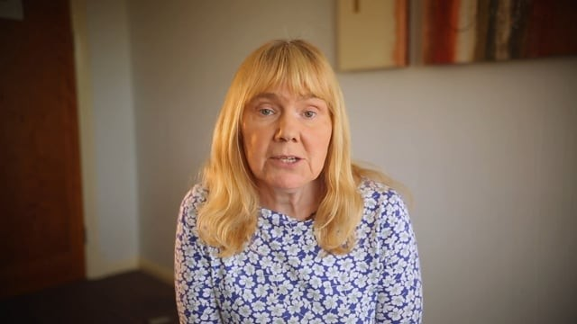
Fractions, Decimals and percentages

Slide 18
Workshop Fractions
Year 2- Part part whole
Year 3 – Fractions of amount
Year 4- Equivalent fractions
Year 5 – Converting improper fractions to mixed numbers and vice versa. Using numicon
Year 6- Fractions of amount

Slide 19
Visit classes
Please use the time to sit and work with your child where possible, see their journey in today’s lesson.
Once you hear the Bing Bong- please leave via mian entrance
Reminders please ensure phones are switched off.

