Slide 1

PGL- Liddington
Wednesday 18th March 2026 - Friday 20th March 2026
Notes:
Peter

Slide 2
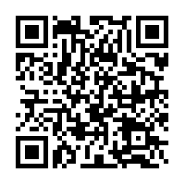
PGL- Liddington
Liddington Adventure Centre, Wiltshire - Primary School Trips (pgl.co.uk)
Notes:
Peter

Slide 3
PGL- Liddington
Children are supervised by Red Oaks staff throughout the day and available to children where necessary overnight.
Children are kept engaged and active as much as possible throughout the day!
Contact- regular updates and photos posted on the year 5 page on Class Dojo. Emergency contacts where necessary.
Liddington Adventure Centre, Wiltshire - Primary School Trips (pgl.co.uk)
Notes:
Sophie

Slide 4
We will be leaving Red Oaks at 11am to arrive at PGL Liddington for 12noon.
All children will need to bring a packed lunch in a disposable bag for this meal.
We will return to Red Oaks on Friday at about 2:30pm and children will be picked up from the hall from 2:45pm.
Notes:
Sophie

Slide 5
Essentials:
Water bottle (labelled)
Bedding – sleeping bag and pillow are perfect
Children to pack with you please! Include contents list for repacking on Friday!
Avoid new, white, expensive clothing
Name EVERYTHING!
Notes:
Sophie

Slide 6
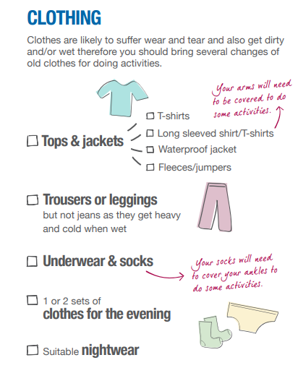

For our 3 day visit, we recommend at least two tops/trousers a day, just in case one gets wet/dirty.
Some activities will require long trousers and long sleeves so don’t assume shorts will be ok!
Sensible PJs
Notes:
GRace

Slide 7
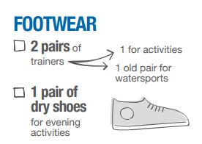
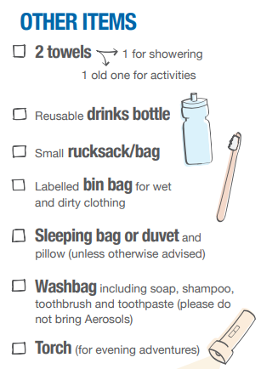
If your trainers have laces – you need to be able to tie them!
Notes:
Grace

Slide 8

Notes:
Grace

Slide 9
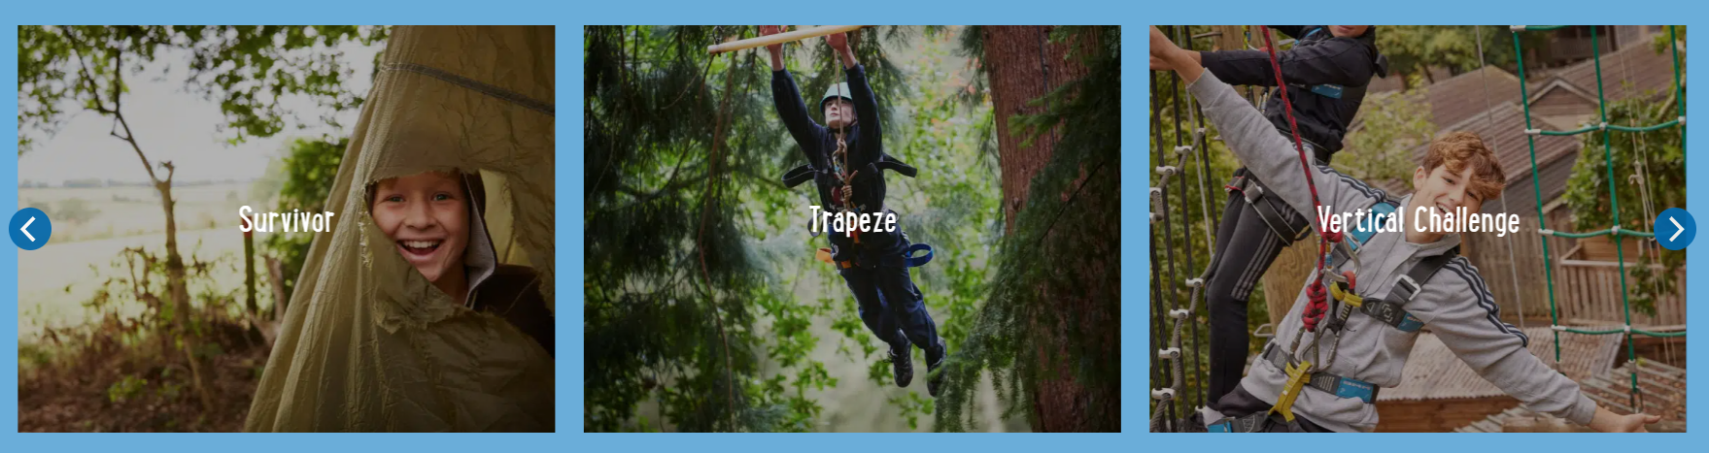
Groups and activities
All children will be able to request some friends to share a room with (we will endeavour to accommodate at least one of these choices)
Year 5 teachers will carefully select room groups (5 per room) and these will be explained on arrival
Some example activities (we find out on arrival) https://schoolsandgroups.pgl.co.uk/centres/liddington/#activities
Notes:
Peter

Slide 10
Extras
No electronics (no cameras/phones)- teachers will take plenty of photos for the website and Class Dojo when possible
Book/card games
Children will be able to take a small amount of money for the shop £5 max – please do not send more as they won’t be able to spend it. (Please hand this in to your class teacher in a named envelope on Wednesday morning – you will need to sign to confirm)
Notes:
Peter

Slide 11
Medication
Any medication to be handed to Mrs Jacques on Wednesday morning. I will be outside the year 5 classrooms. You will need to write out dose information and sign a consent form.
This includes Calpol and other over-the-counter medication such as antihistamines
ALL medication must be described in detail on the medical/dietary form handed in prior to visit.
Notes:
Peter

Slide 12
Any questions?
Please contact us via class email addresses with any questions.
hazel@redoaks.org.uk
beech@redoaks.org.uk

