Slide 1
Reading Workshop

Slide 2
agenda
Reading for purpose
What are you reading and why?
Reading for pleasure
How to approach reading with your child so it’s entertaining and not a “chore”
Reading fluency - phrasing

Slide 3
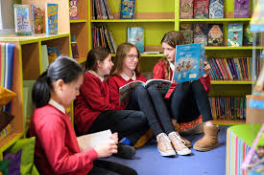
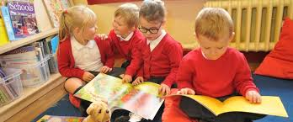
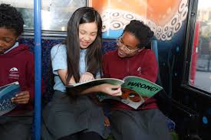
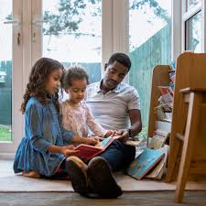
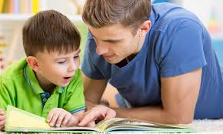
The power of Reading
“…reading can support personal, social, and emotional development, enabling better mental health and greater capacity for empathy and critical thinking” authors Dominic Wyse and Charlotte Hacking explain.

Slide 4
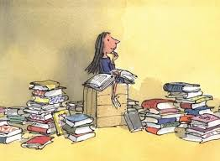
“The books transported her into new worlds and introduced her to amazing people who lived exciting lives.”
Matilda – Roald Dahl

Slide 5
Overcoming Barriers to reading
An important factor in developing reading for pleasure is choice.
Young people that use their public library are nearly twice as likely to be reading outside of class every day (Clark and Hawkins, 2011).
Local libraries – also have online libraries
included these days.
Parental involvement
Reading is a source of entertainment
Children are more likely to continue to be readers in homes where books and reading are valued
Dyslexia
Audio books and follow along texts are useful in supporting children with dyslexia.
Dyslexia friendly fonts and coloured overlays
Confidence-building strategies
Access (physically and cognitively)
Enjoyment

Slide 6
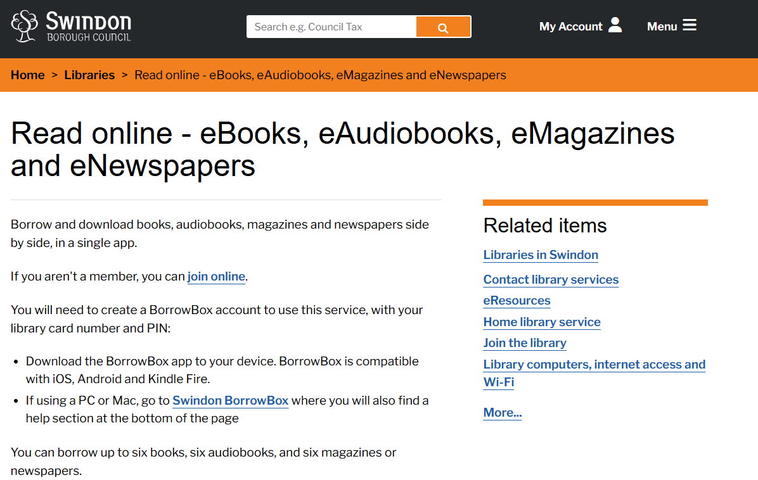

Slide 7
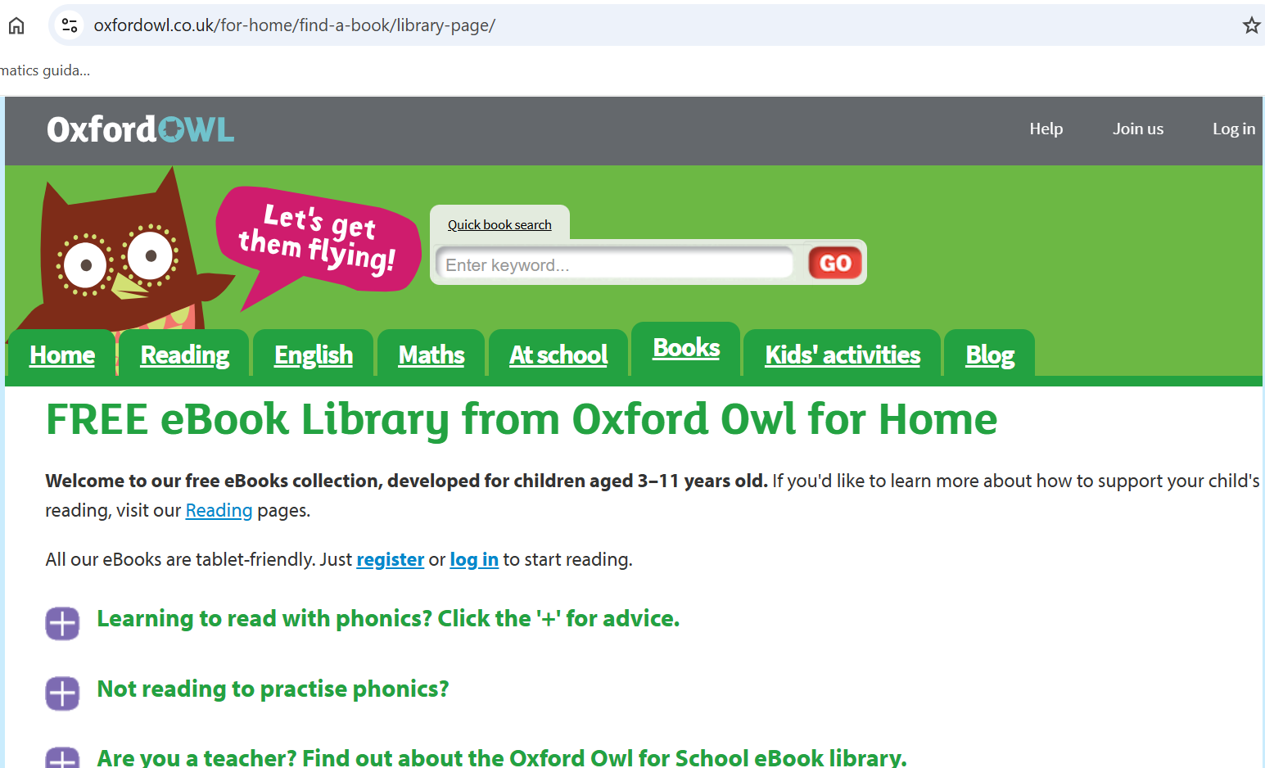
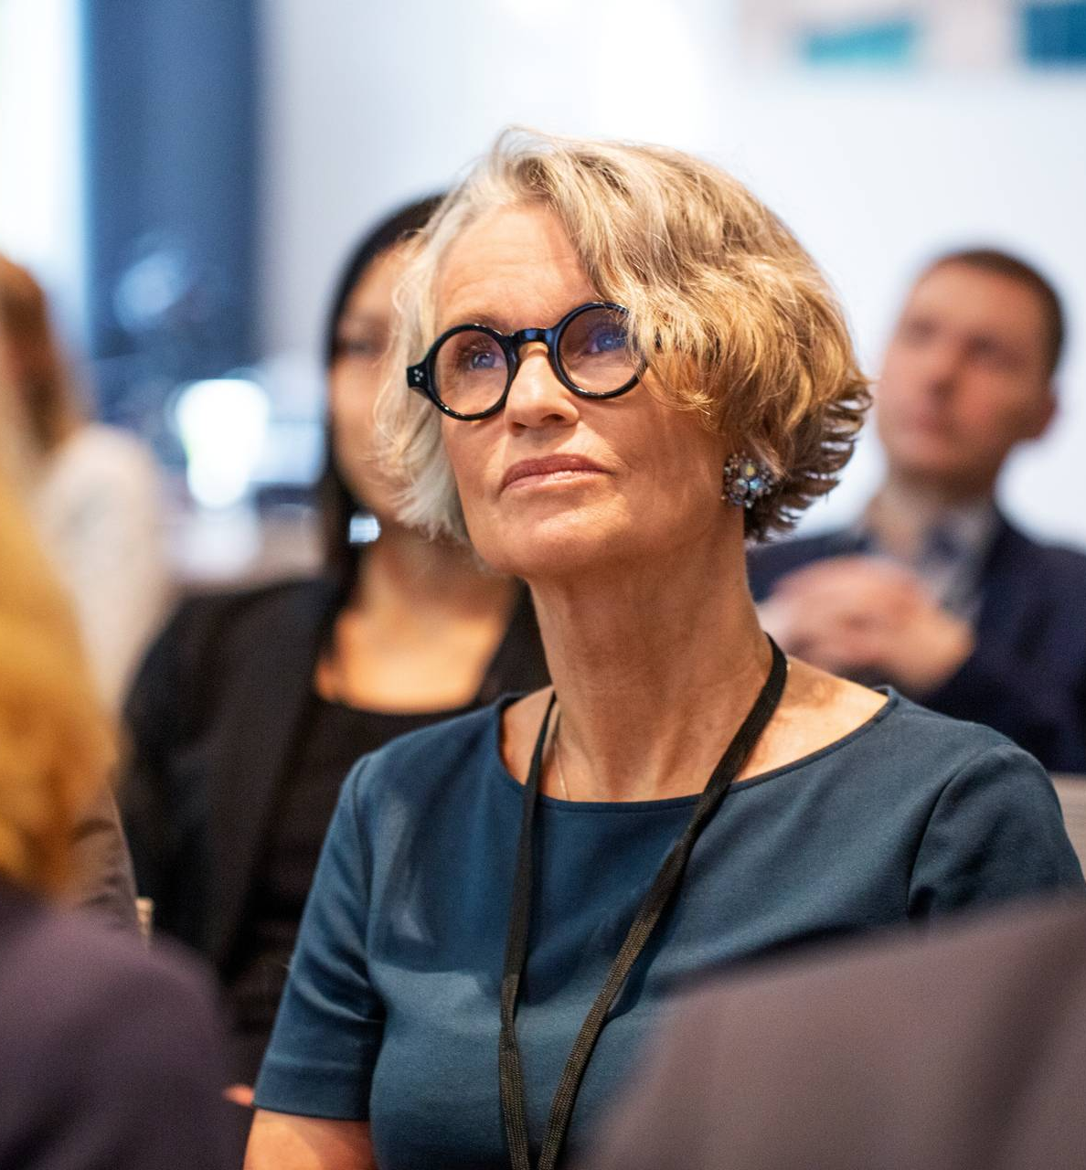
..
..
Notes:
https://www.oxfordowl.co.uk/for-home/find-a-book/library-page/

Slide 8
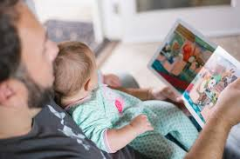
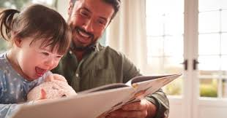
Engaging with your child
Fostering a love of reading “Teaching about sounds is meaningless unless it is contextualised in words, sentences and whole texts.”

Slide 9
Reading for pleasure
'Reading for pleasure' has been defined by the National Literacy Trust as “reading that we do of our own free will, anticipating the satisfaction that we will get from the act of reading.”
The National Literacy Trust has a lot of support for parents and carers reading for enjoyment and entertainment with their children.
(next page)

Slide 10
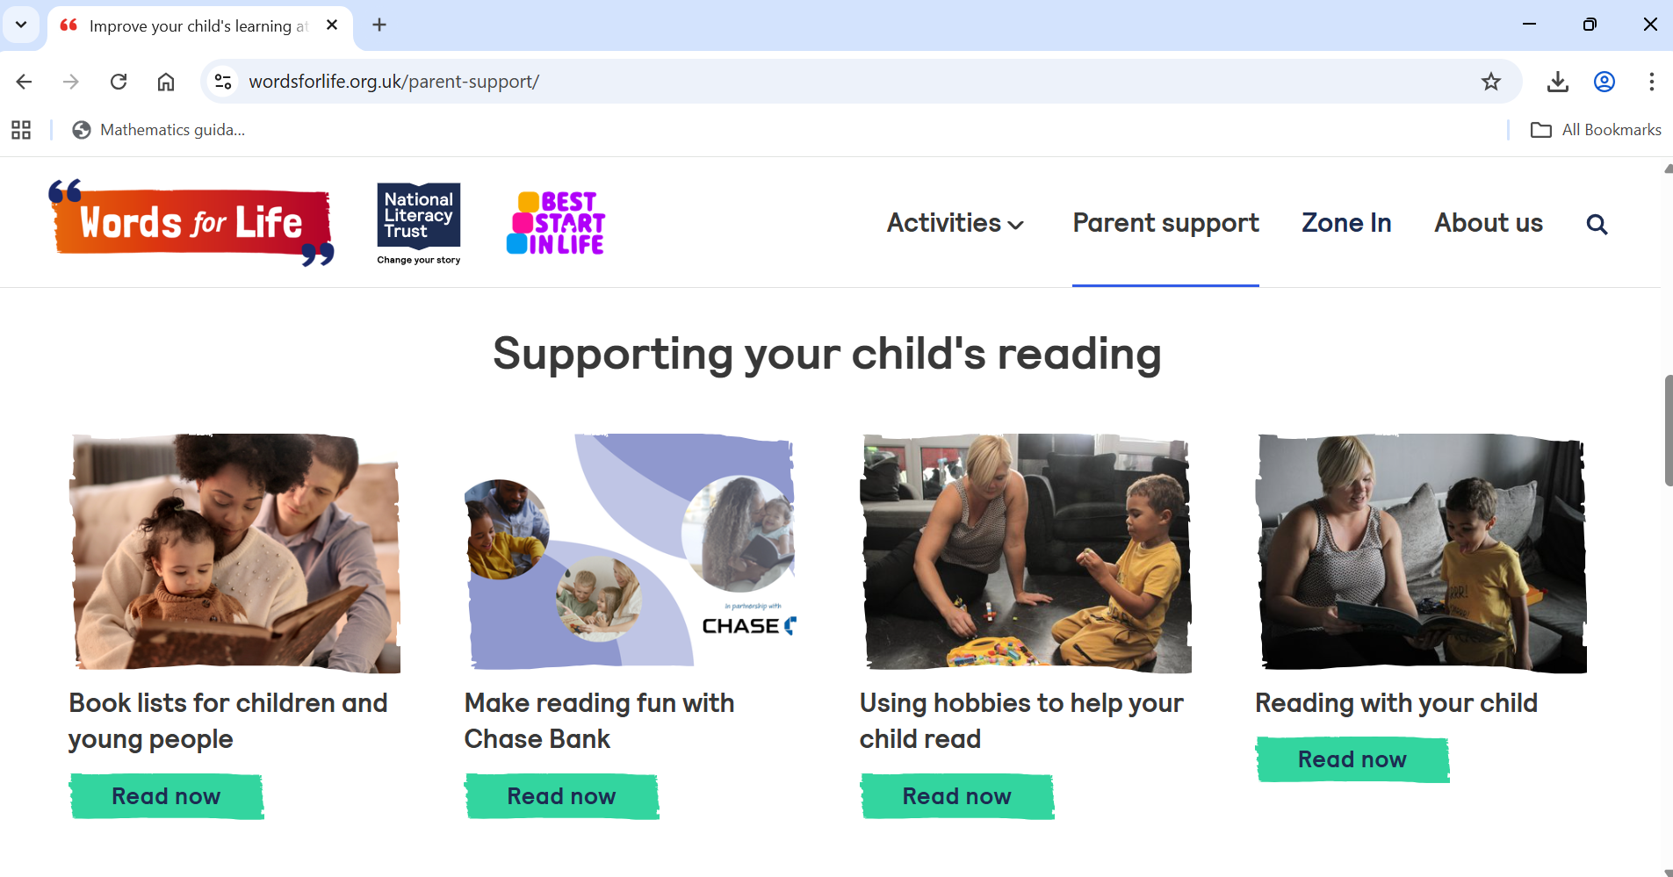
National Literacy Trust
https://wordsforlife.org.uk/parent-support/
Notes:
https://wordsforlife.org.uk/parent-support/reading-your-child/

Slide 11

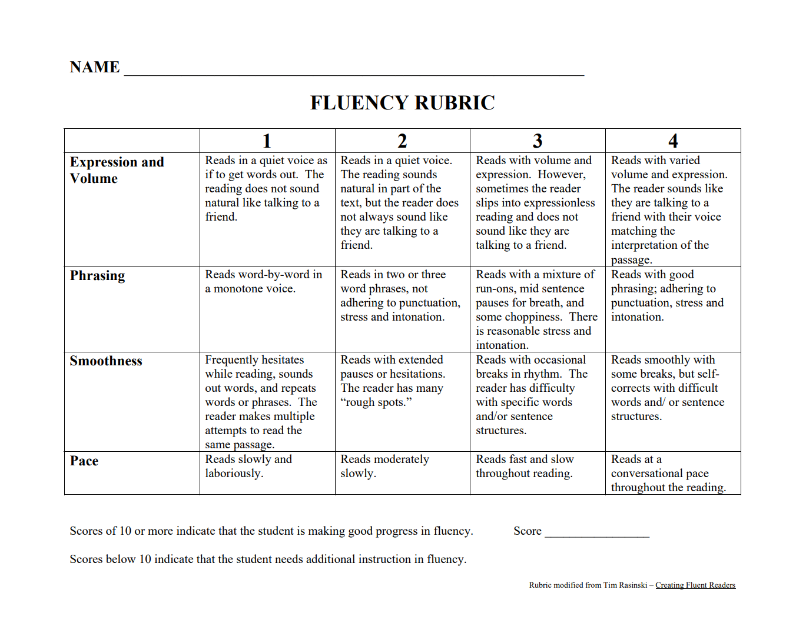
Reading fluency – modelling what reading aloud sounds like (phrasing)
..
Teachers use this.
How can you support you child?

Slide 12
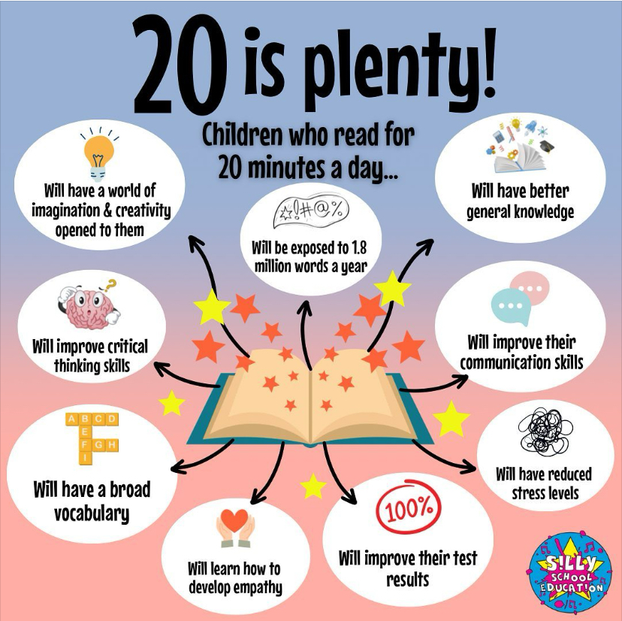
Take-aways
Little and often
Something of their own choosing (audio book, magazine, comic, graphic novel, chapter book, recipes, non-fiction)
Shared as entertainment rather than something that “has” to be done.

Slide 13
Thank you
Ms S Duffin willow@redoaks.org.uk
English Lead
Year 2 Teacher

