Slide 1

Welcome to Year 2
2025-2026
Ms Duffin (Willow Class)
Miss Hawkins (Birch Class)
Notes:
SD

Slide 2
Contact us
Mrs Painter – head@redoaks.org.uk
Mr Lee - deputyhead@redoaks.org.uk
Mrs Walton - y1.2@redoaks.org.uk
Ms Duffin – willow@redoaks.org.uk
Miss Hawkins – birch@redoaks.org.uk
Office – office@redoaks.org.sch.uk
Notes:
SD

Slide 3

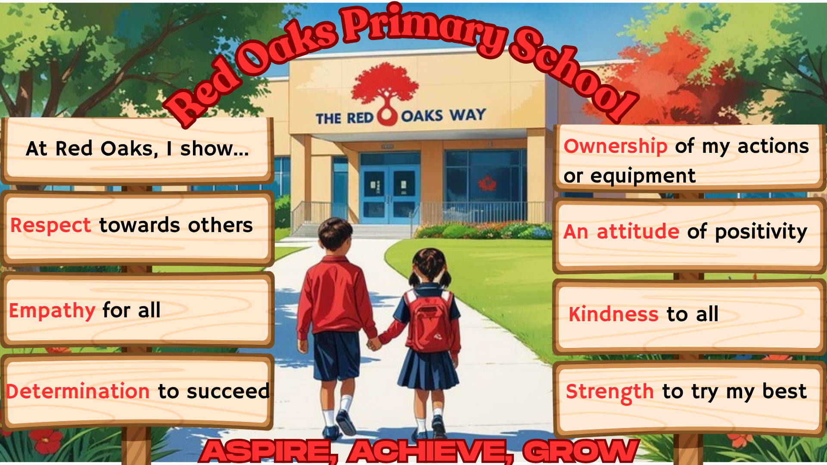


Slide 4
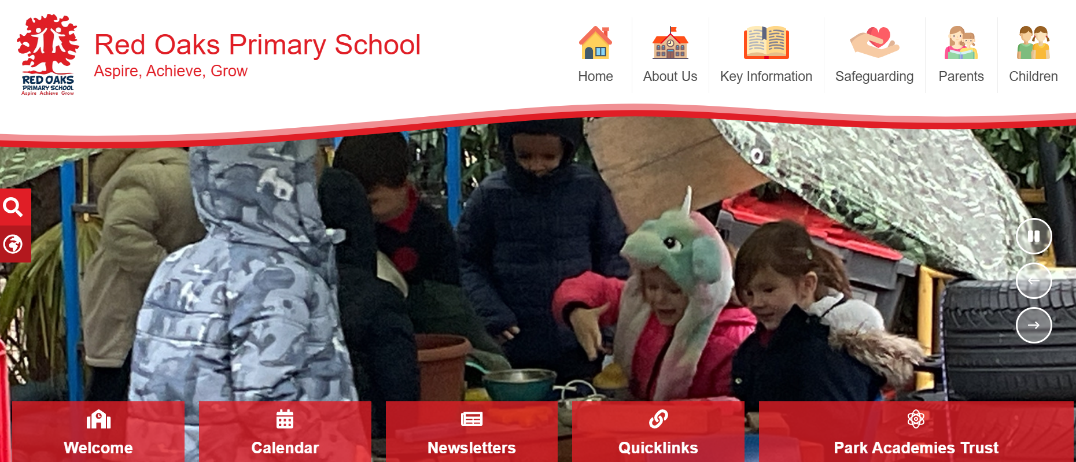
www.redoaks.org
The School Website
Notes:
MH

Slide 5
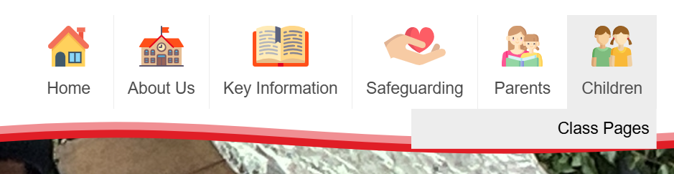
Children
Notes:
MH

Slide 6
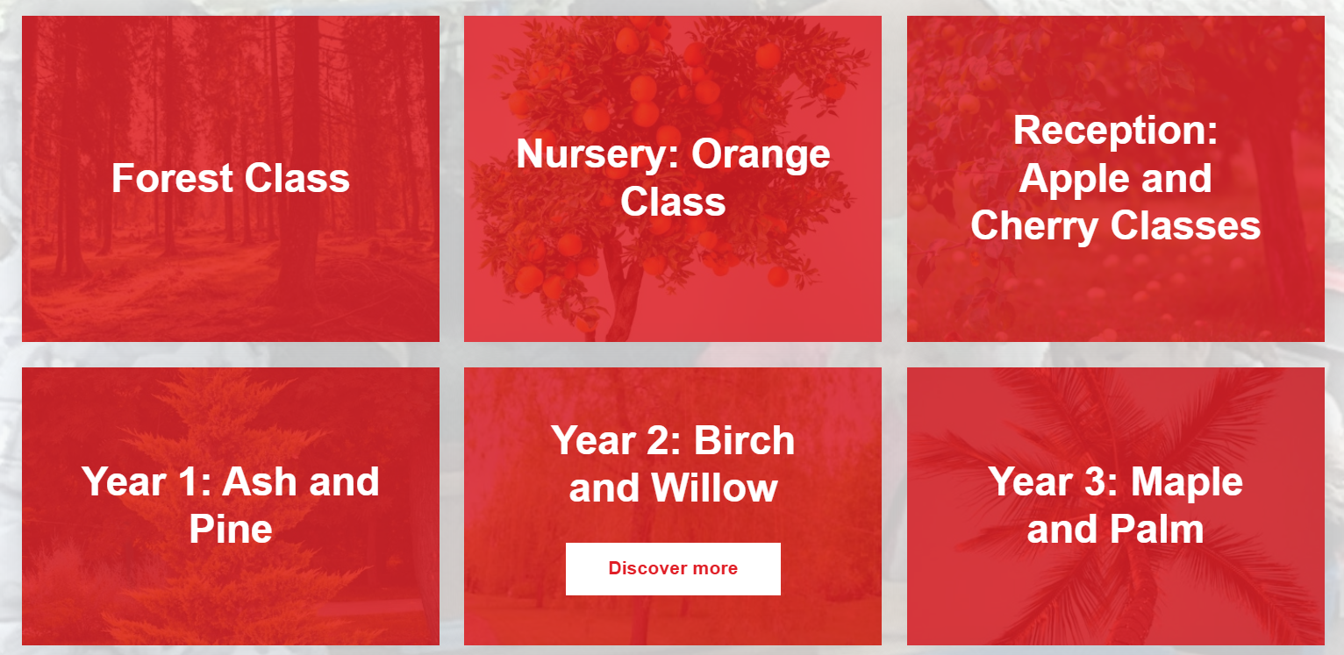
Under the year group you will find photos later in the term and class news.
Notes:
MH

Slide 7
Mornings
Doors open at 8:30
Register promptly at 8:40am – please be on time, gate will close at 8.40am – children will be marked late if arriving after this time.
Children will be independent reading when they come into class. We promote independence when they come in and to get themselves organised.
Notes:
SD

Slide 8
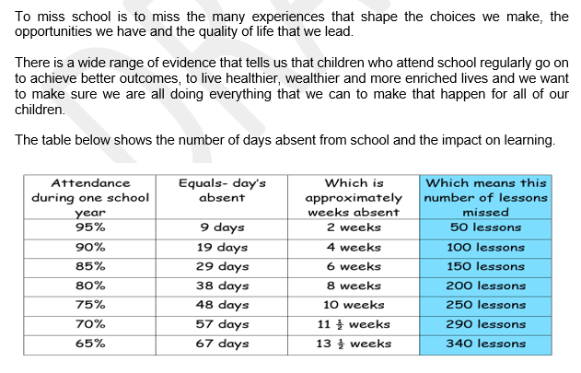
Attendance
Notes:
SD

Slide 9
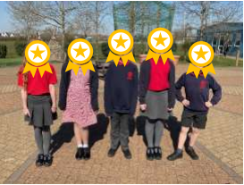
Uniform
• Grey trousers/shorts/skirts/pinafores (no leggings)
• Red polo shirts
• Navy blue polo shirts (Y6 only)
• Navy blue sweatshirt/fleece/cardigan (with or without school logo)
• White, grey or black socks or tights
• Red checked summer dress (gingham dress)
• Black, flat-heeled shoes (not slip-on) – no trainers
• Summer sandals may be worn in warmer weather but no open toes
• Hair bands must be red or navy
• No large hair accessories, including animal print/shaped hair bands and birthday headdresses,
are permitted.
• A simple watch may be worn but no smart watches
• Hat in warm weather
Notes:
MH

Slide 10
PE
2 x week (Monday and Wednesday)
Indoor (Monday) and Outdoor (Wednesday)
Please arrive dressed in PE kit on these days.
House coloured t-shirt (plain)
PE is a compulsory subject therefore a letter or phone call is needed if children are unable to participate.
Notes:
MH

Slide 11



Reading
Library Books – Book Bands and Book for pleasure
New reading records must come to school everyday.
Reading every day is essential.
It is important that children read a range of different types of genre/texts and that these are recorded in their reading record.
Notes:
SD

Slide 12

Maths
It is important children know ALL their times tables by Year 4! In Year 2, we will start this journey by learning the 2, 5 and 10 table. Once confident, 3 times tables introduced.
Number bonds to 10 and 20.
Be able to tell the time at home to the nearest quarter of an hour.
Money – play shops
There are lots of good maths apps and logins will be available to children.
https://kids.classroomsecrets.co.uk/
Numbots
www.ttrockstars.com/login
Notes:
MH

Slide 13
Spellings
Weekly spellings- (10 words in total)
    3 Common exception
    5 follow previously learnt pattern
    2 mystery words
It is important they learn these in exciting ways.
Not just for the test
In class, the aim is that the children then apply these spellings consistently.
Notes:
SD

Slide 14
Homework
Published on website and on Dojo
Spelling and maths (how to videos) will be posted on dojo and a termly project is set by different subject leads (optional)
Due in the last week of term
Shared with the class and the teacher
Notes:
MH

Slide 15
Assessment
T2 , T4, T6
SATS are no longer statutory for Year 2
Children will still receive an end of year level of WTS, EXS or GDS in Reading, Writing, Maths and SPAG (spelling, punctuation and grammar).
Notes:
SD

Slide 16
Any questions?
We will be available briefly on the door every morning or send us an email!
Thank you!

